Slide 1
An Extension of Swarmalator Model

Slide 2
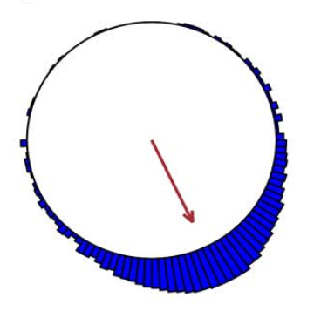
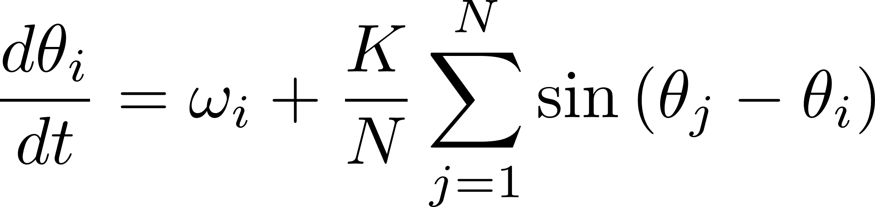
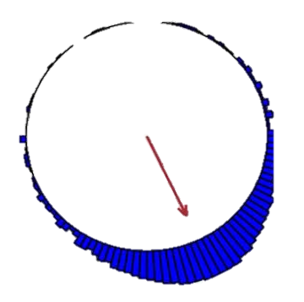
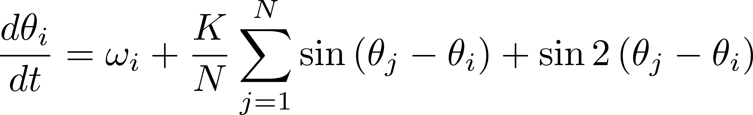
Introduction -Kuramoto model
Modified Model

Slide 3
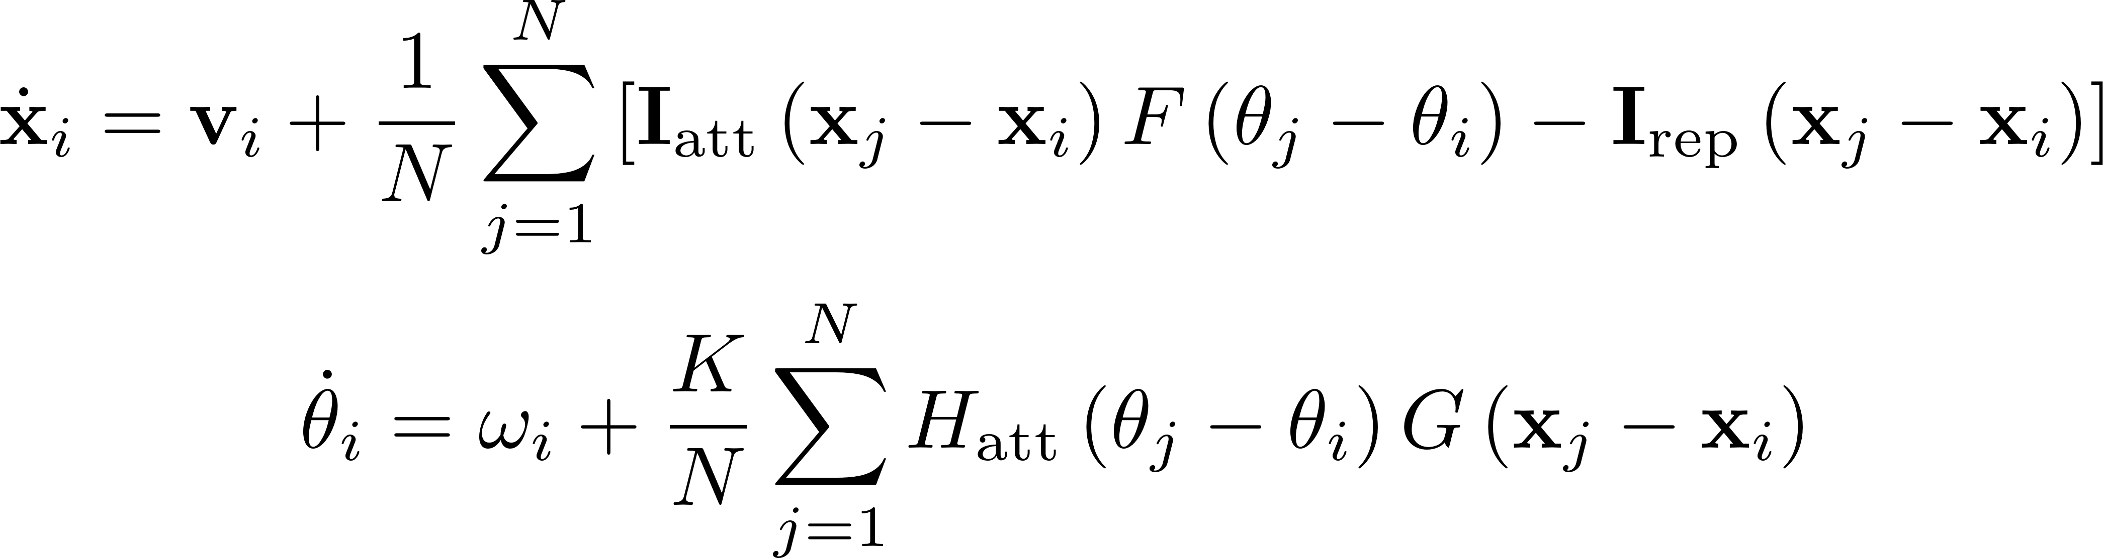
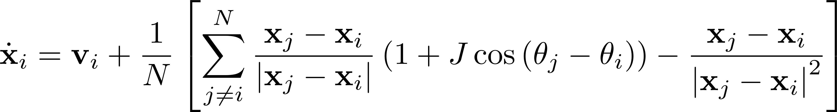
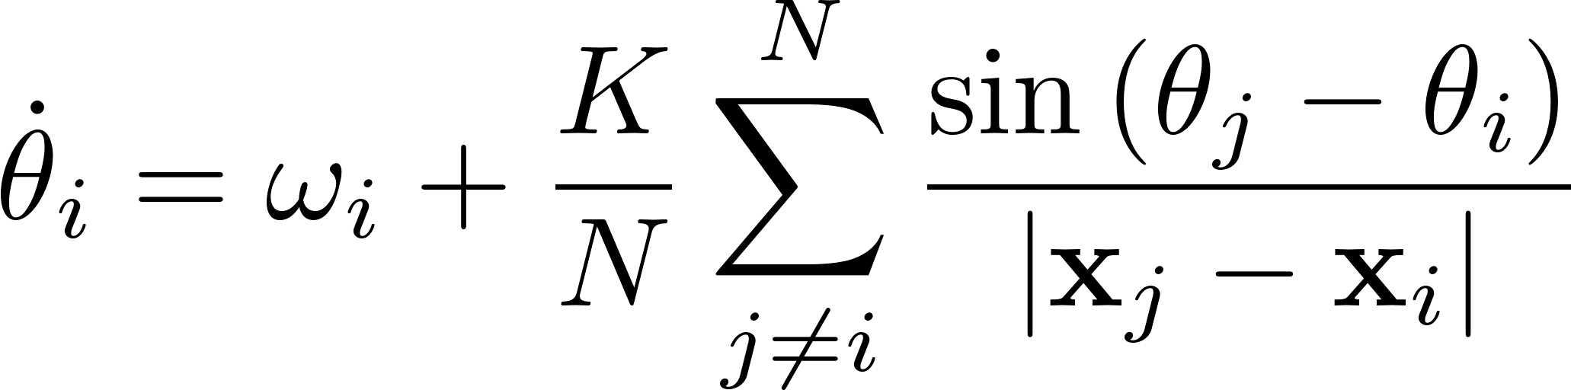
Swarmalator model-Proposed by Kevin P. O’Keeffe
Oscillators whose phase dynamics and spatial dynamics are coupled
In the Paper, this model was used
General model

Slide 4
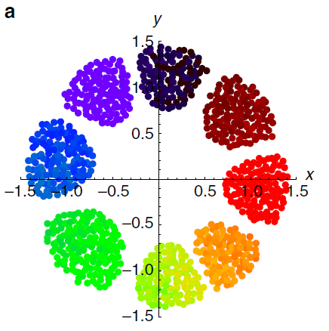
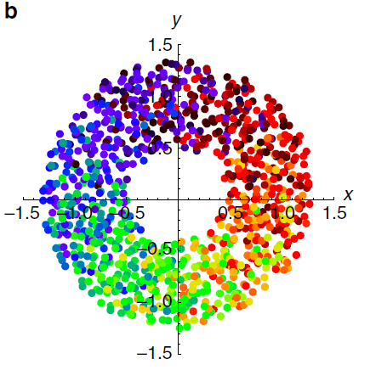
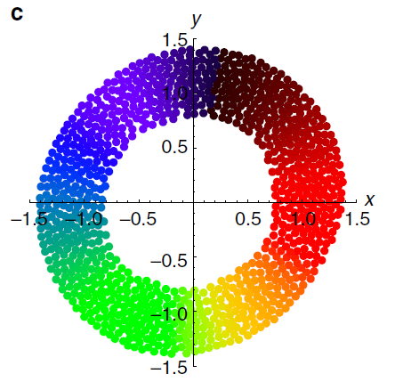
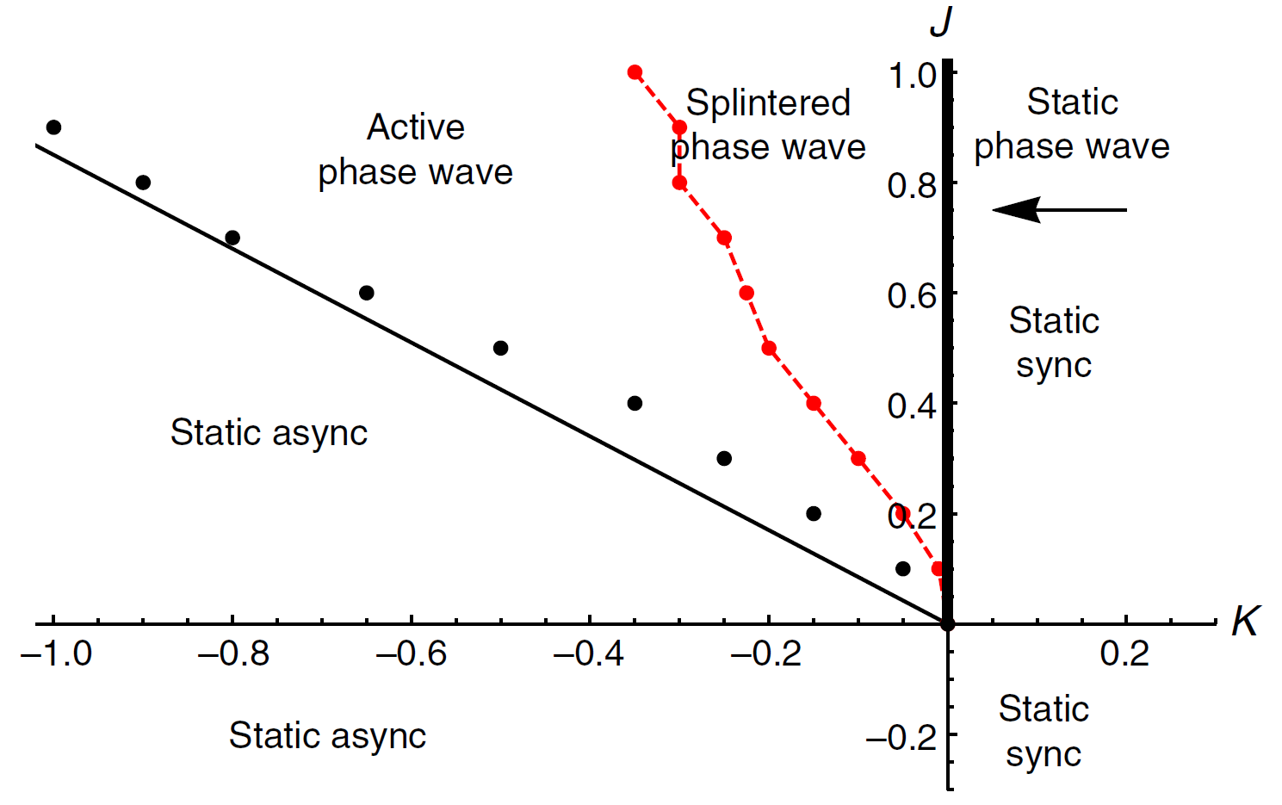
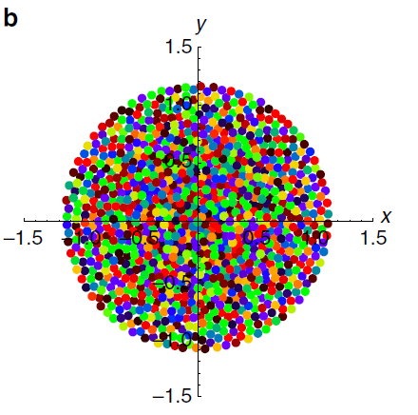
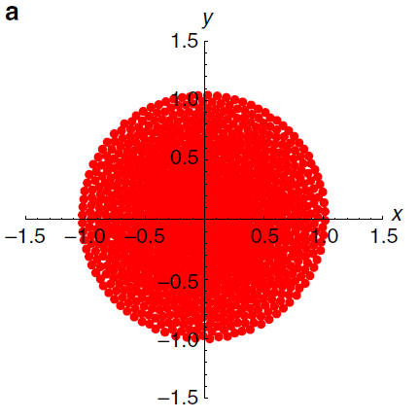

Slide 5
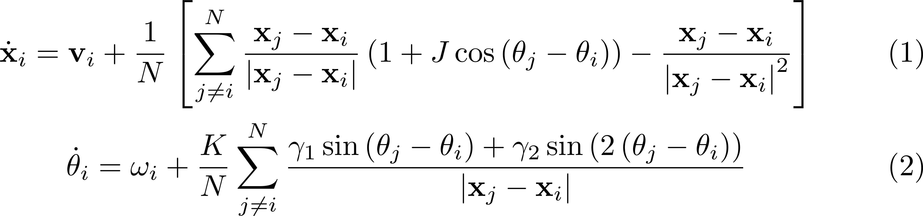
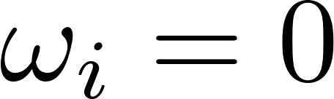
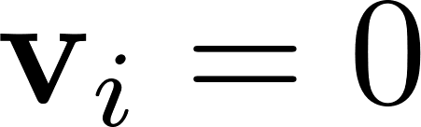
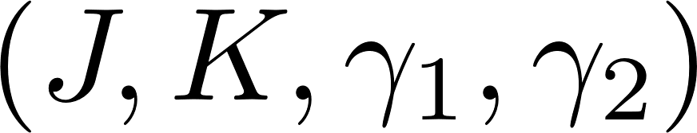
Extension- New model
Modified phase equation to include 2 terms
Assumptions
Identical Swarmalators
No background flow
The system has 4 parameters
Additional Term

Slide 6
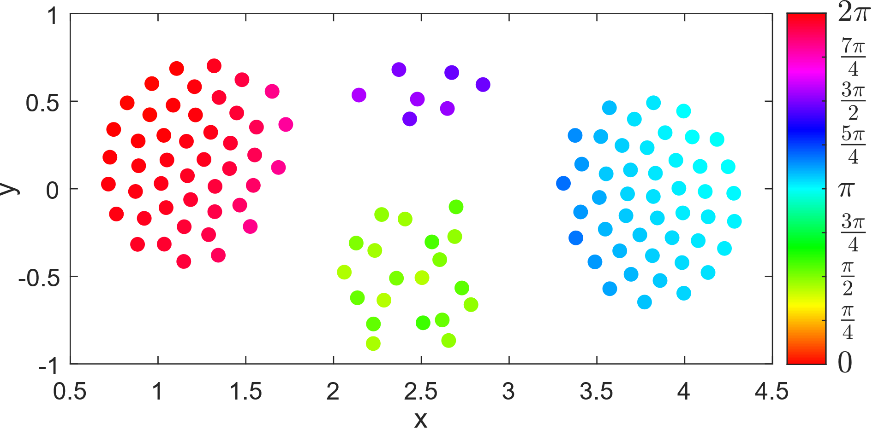
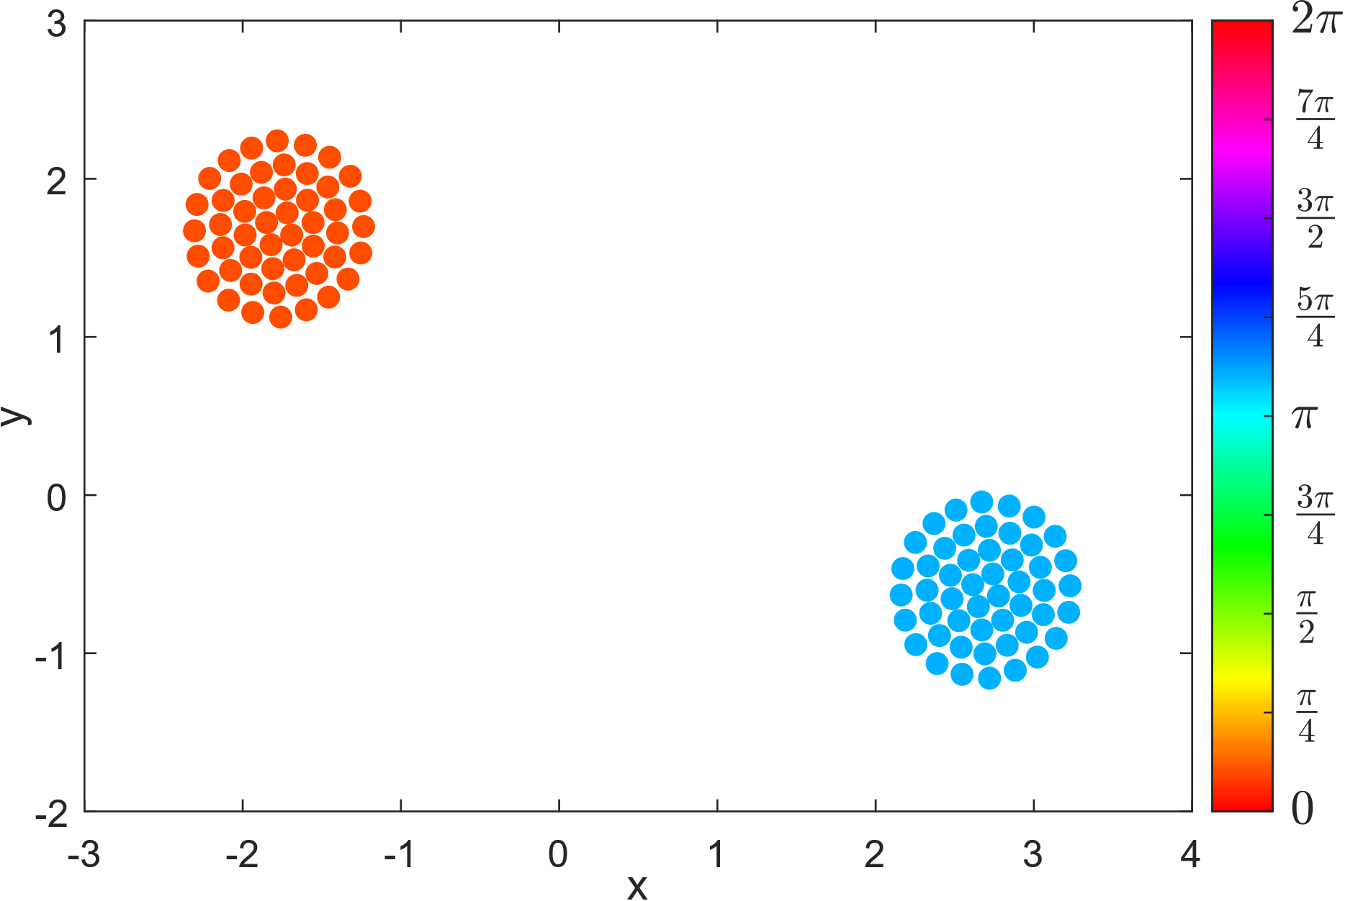
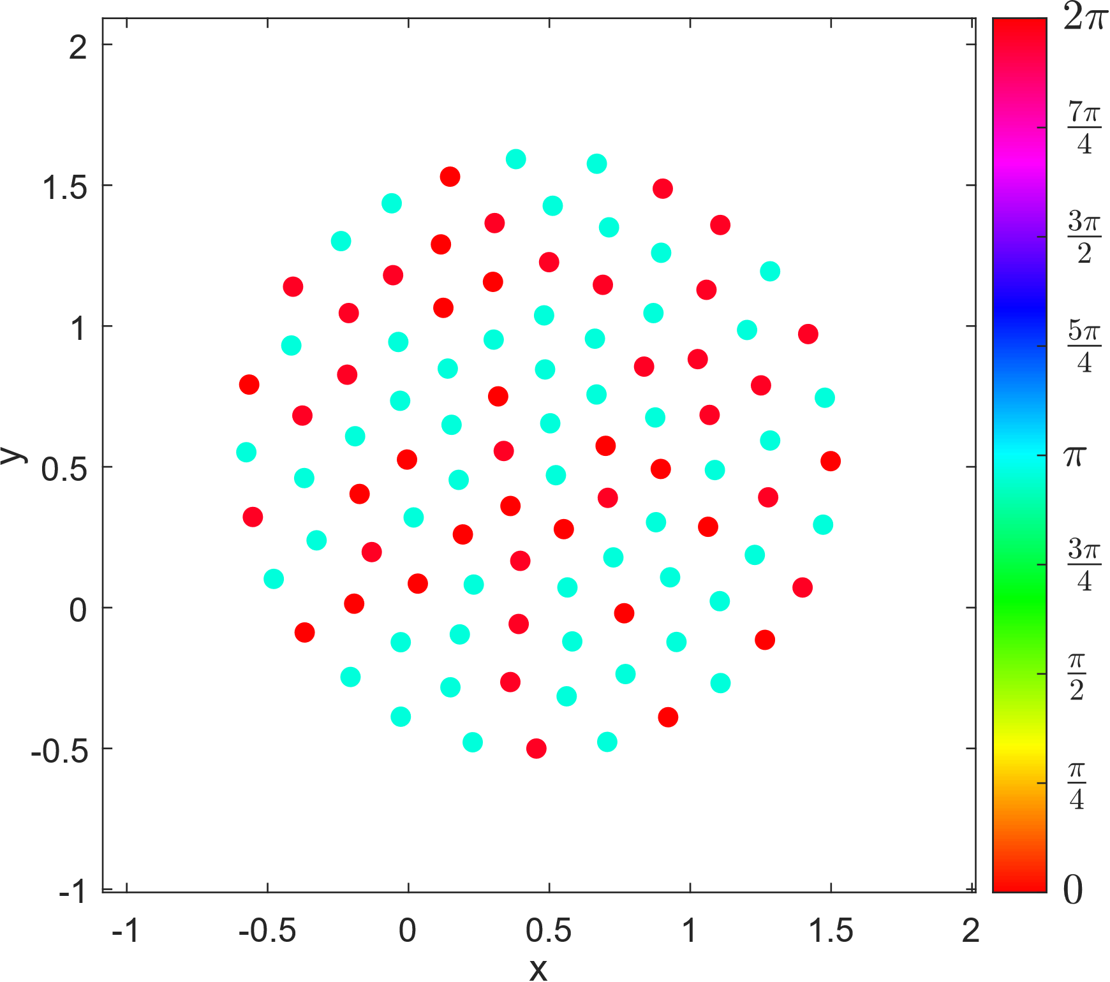
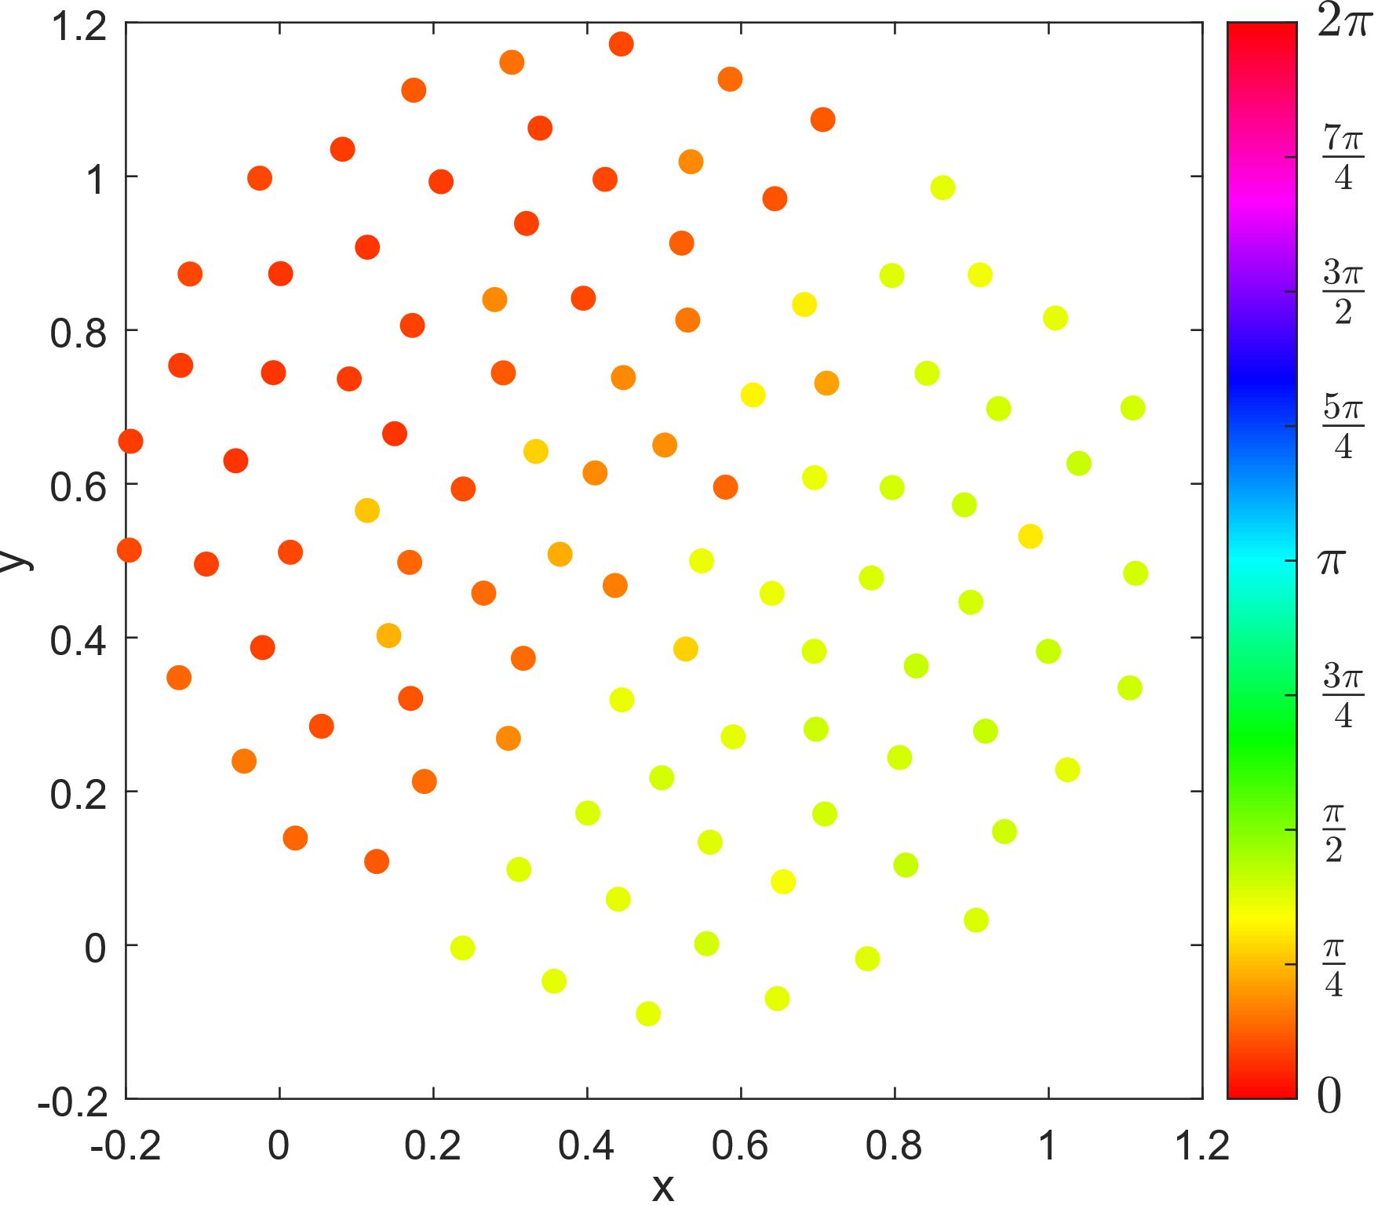
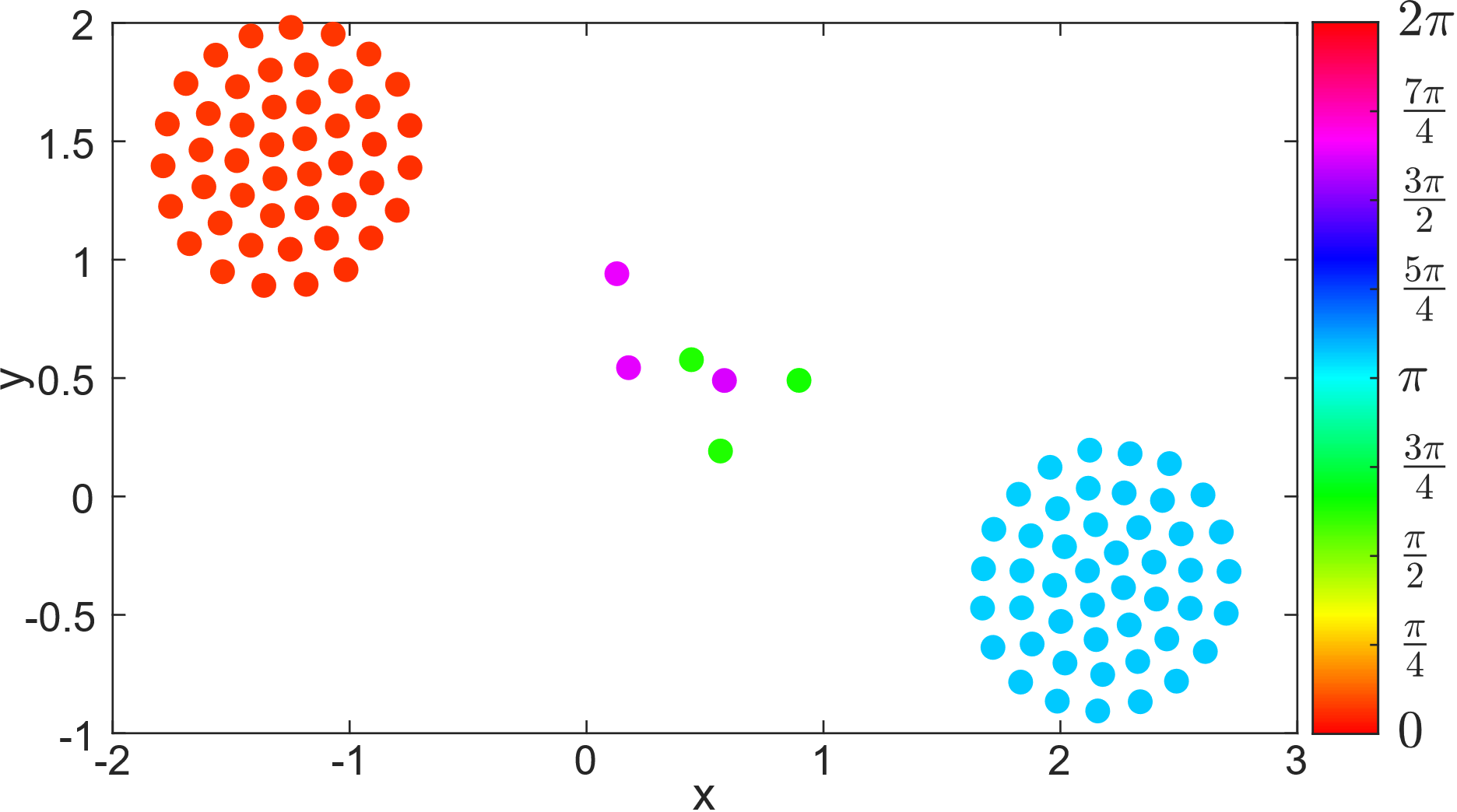
Many New States!
Active Three/four cluster state
Static Two cluster
Static bimodal single cluster
Active Single cluster state
Two cluster with rogues

Slide 7
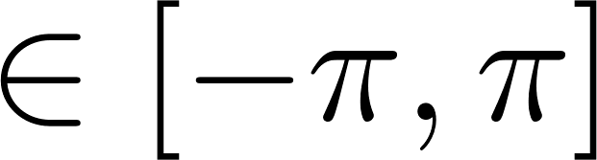
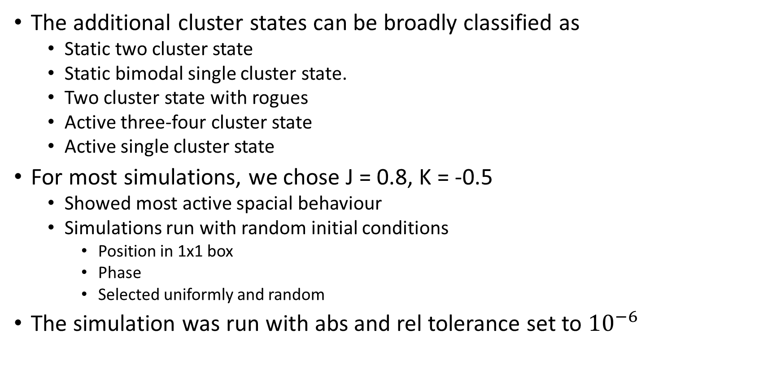
New States
The additional cluster states can be broadly classified as
Static two cluster state
Static bimodal single cluster state.
Two cluster state with rogues
Active three-four cluster state
Active single cluster state
For most simulations, we chose J = 0.8, K = -0.5
Showed most active spacial behaviour
Simulations run with random initial conditions
Position in 1x1 box
Phase
Selected uniformly and random
The simulation was run with abs and rel tolerance set to ${10}^{−6}$

Slide 8
Static Two Cluster State

Slide 9
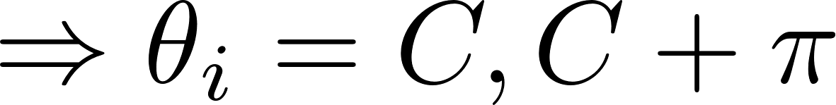
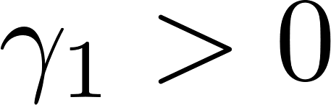
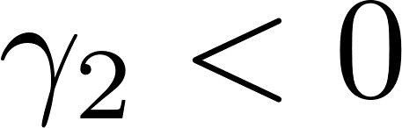
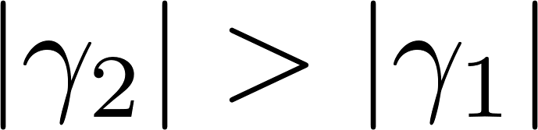
Static Two Cluster State
J > 0, implies “like attract like”
Note: K < 0
Negative coupling
Positive coupling
Two cluster state
T = 100 time steps

Slide 10
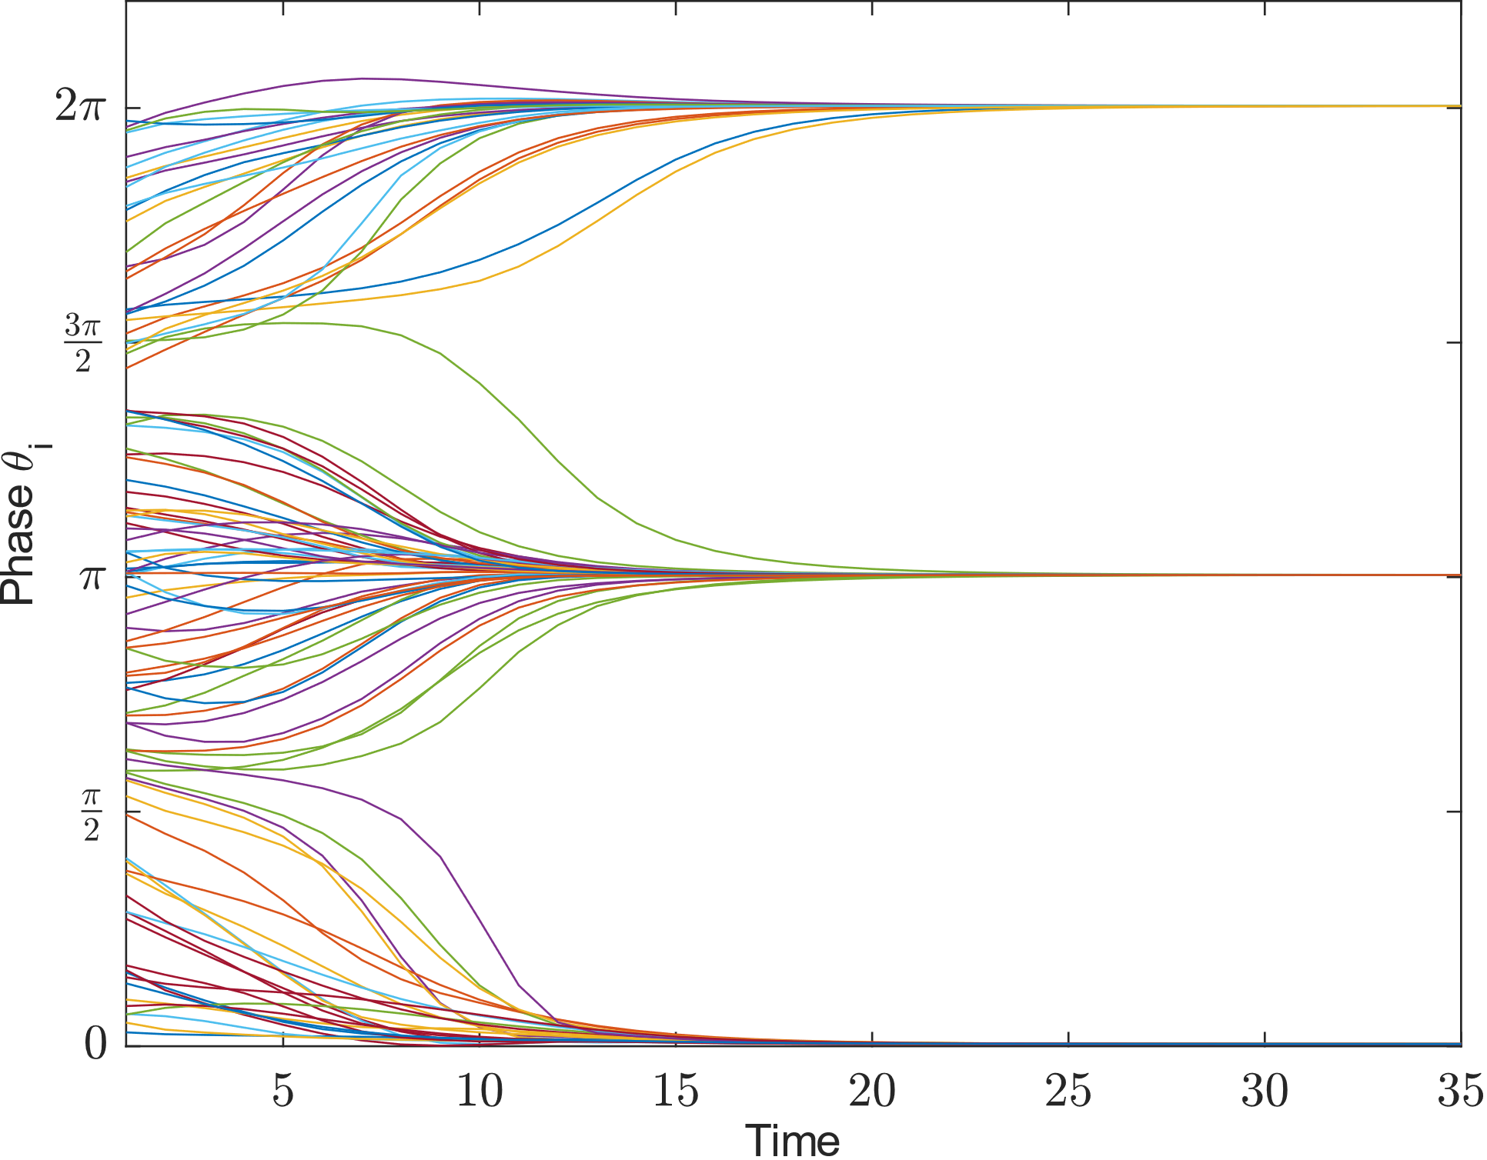
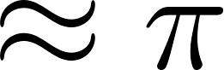
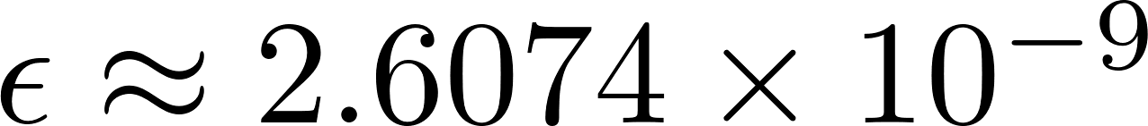
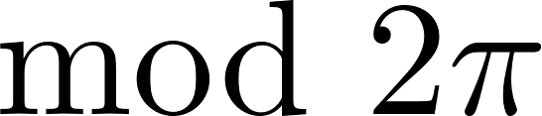
Static Two Cluster State
Stable Phase
System settles to 2 stable phase
Inter cluster phase difference is
Absolute error

Slide 11
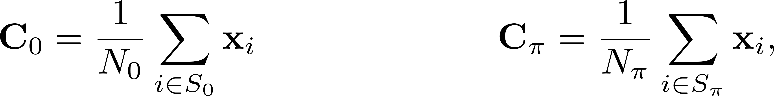
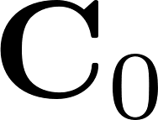
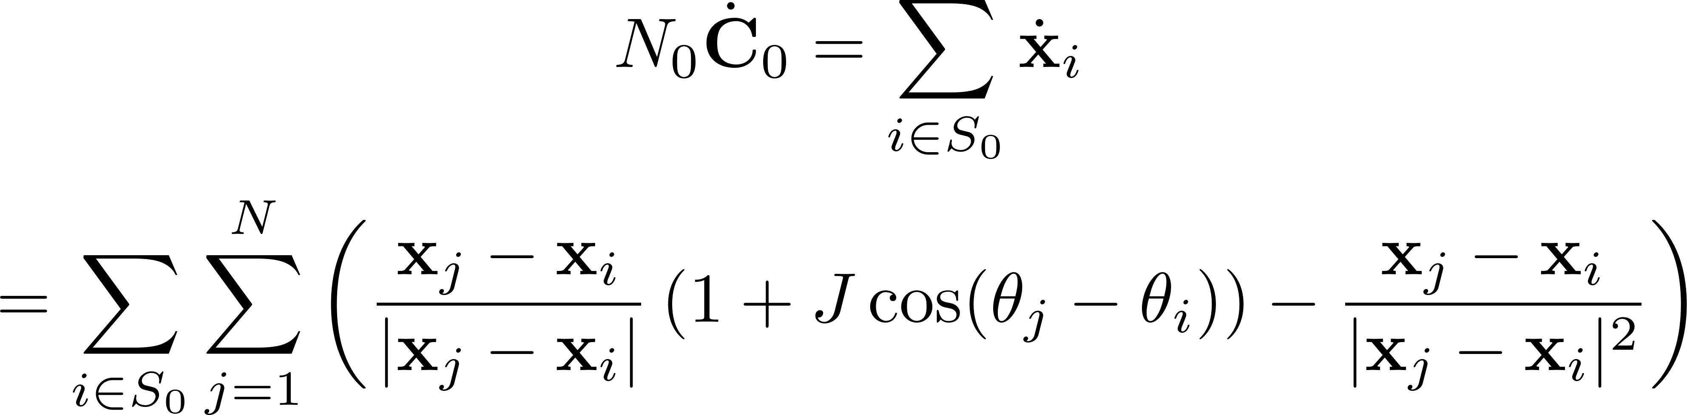
Inter-Cluster Distance
We can analytically solve the inter-cluster distance for static two cluster state
Let,
Differentiating w.r.t time gives
Centroid of clusters

Slide 12
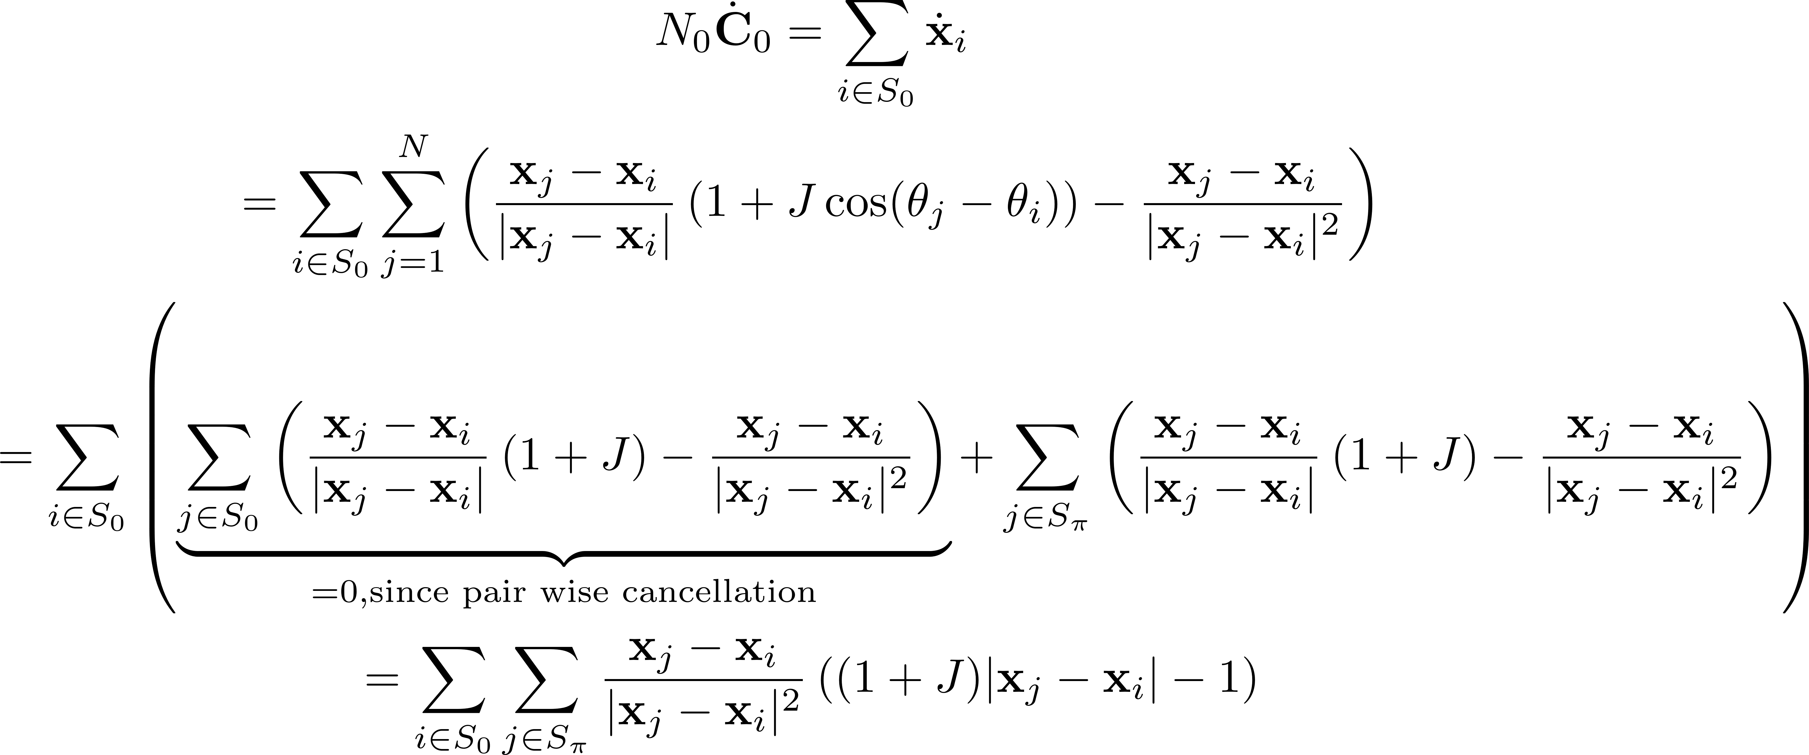
Inter-Cluster Distance

Slide 13
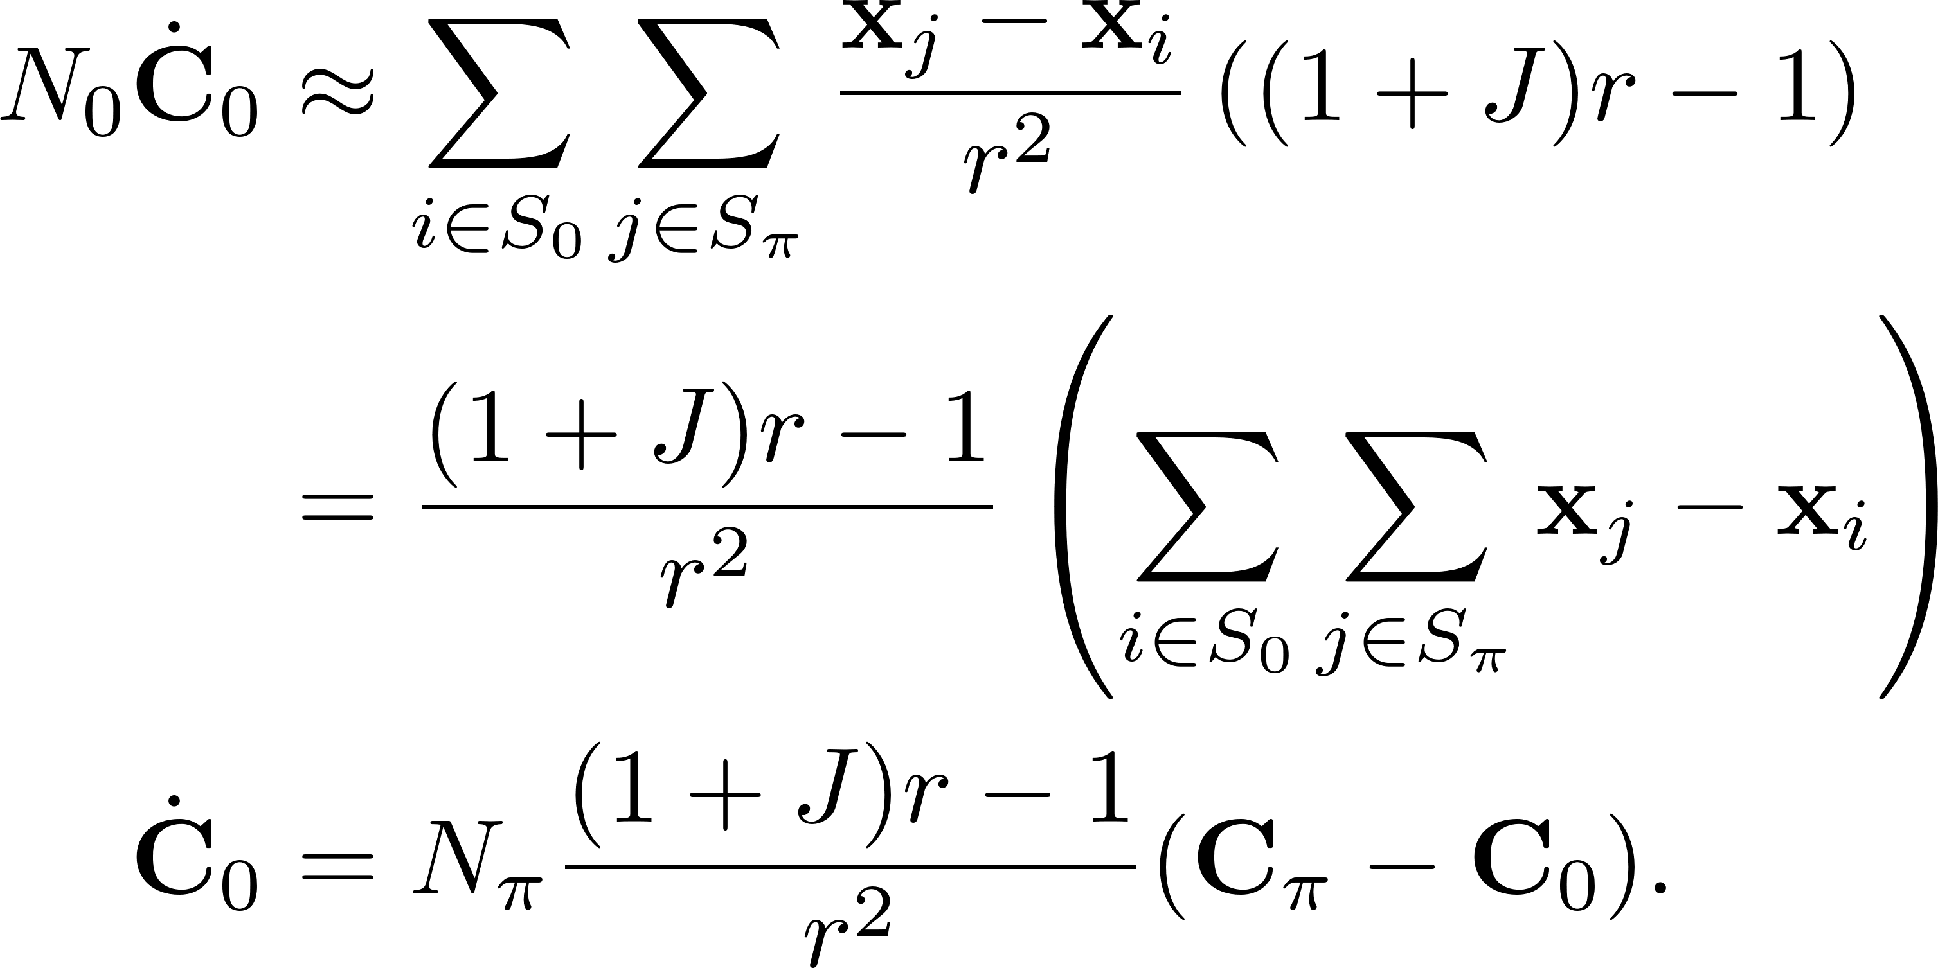
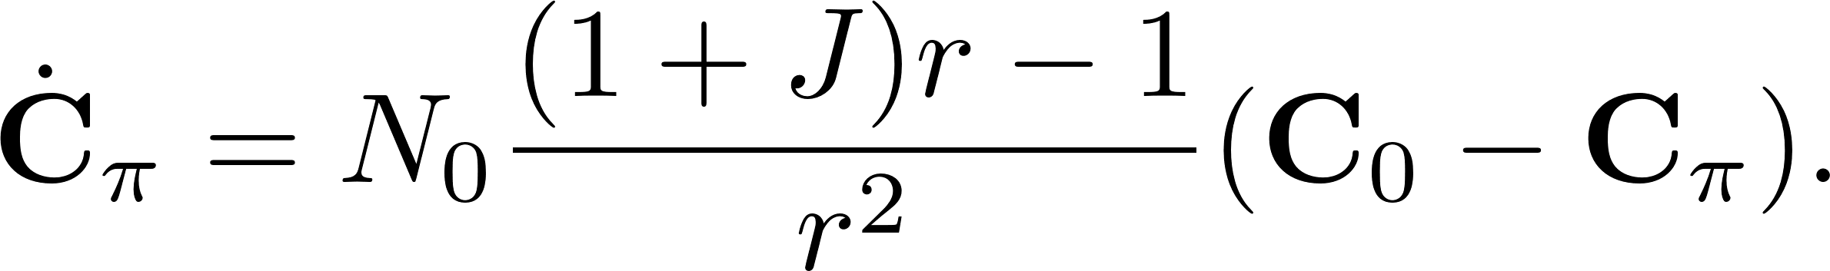
Inter-Cluster Distance
We make the assumption that
Similarly,

Slide 14
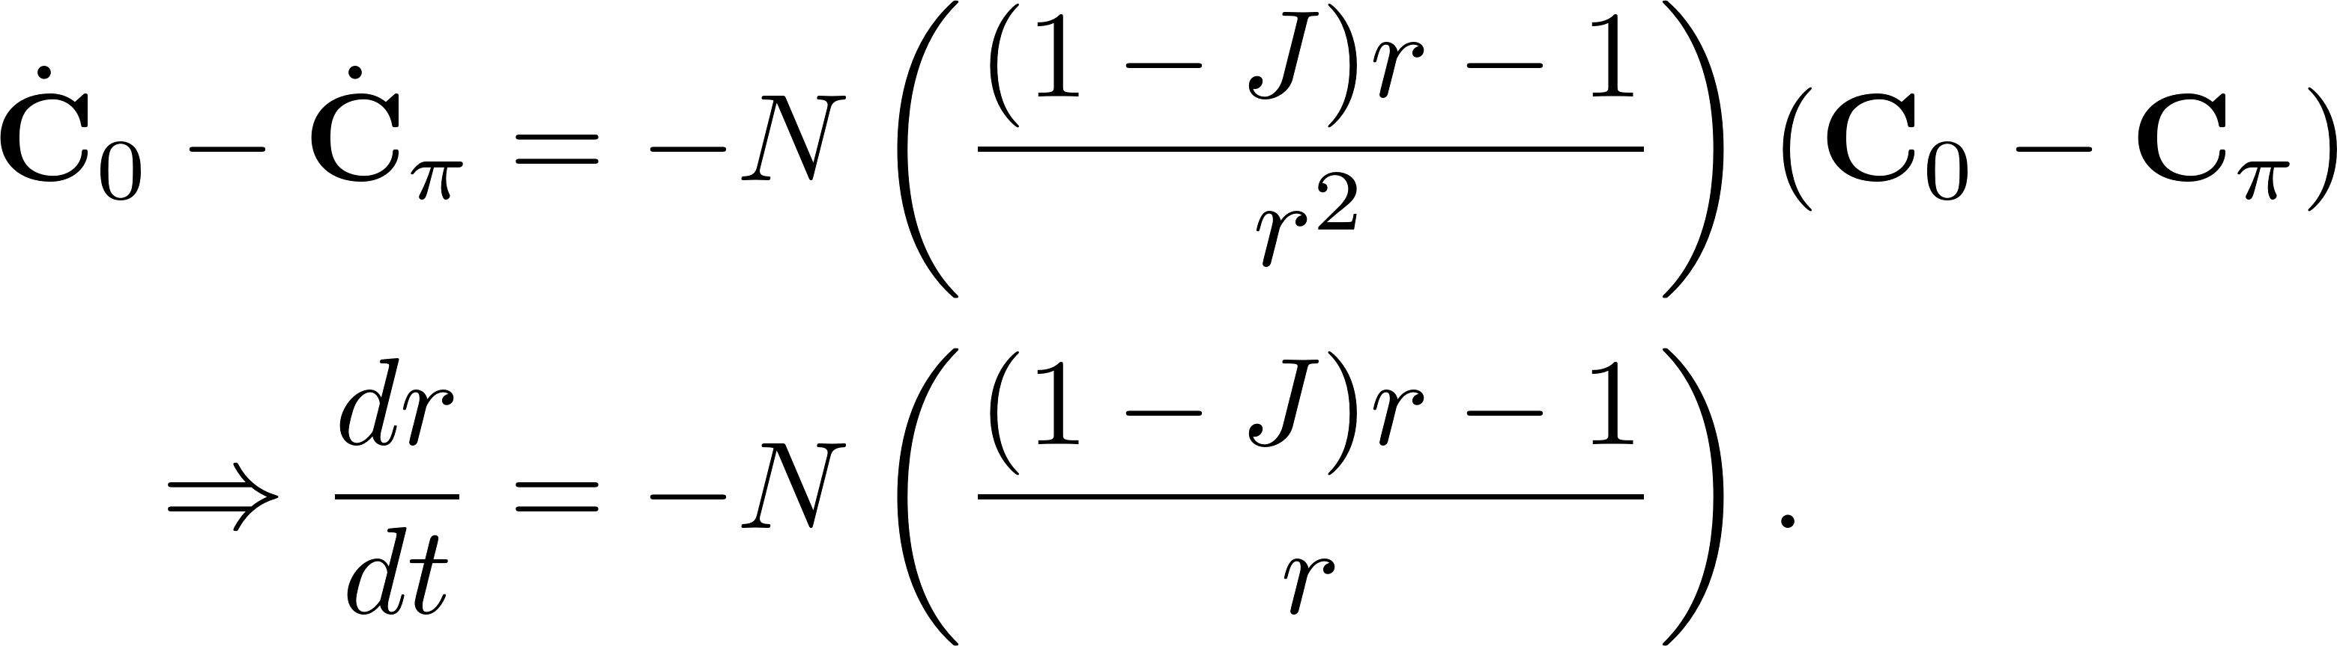
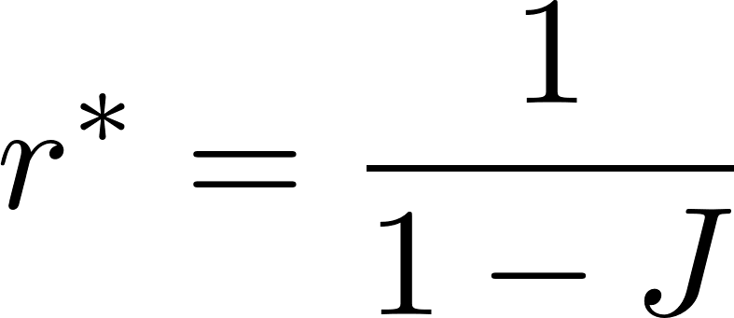
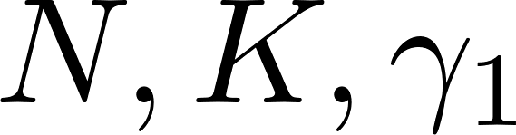
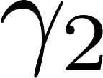
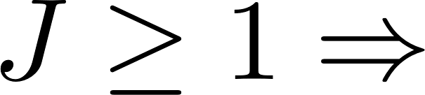
Inter-Cluster Distance
Finally,
Setting to zero gives
Independent of and .
Also, clusters move to infinity

Slide 15
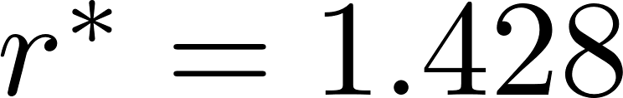
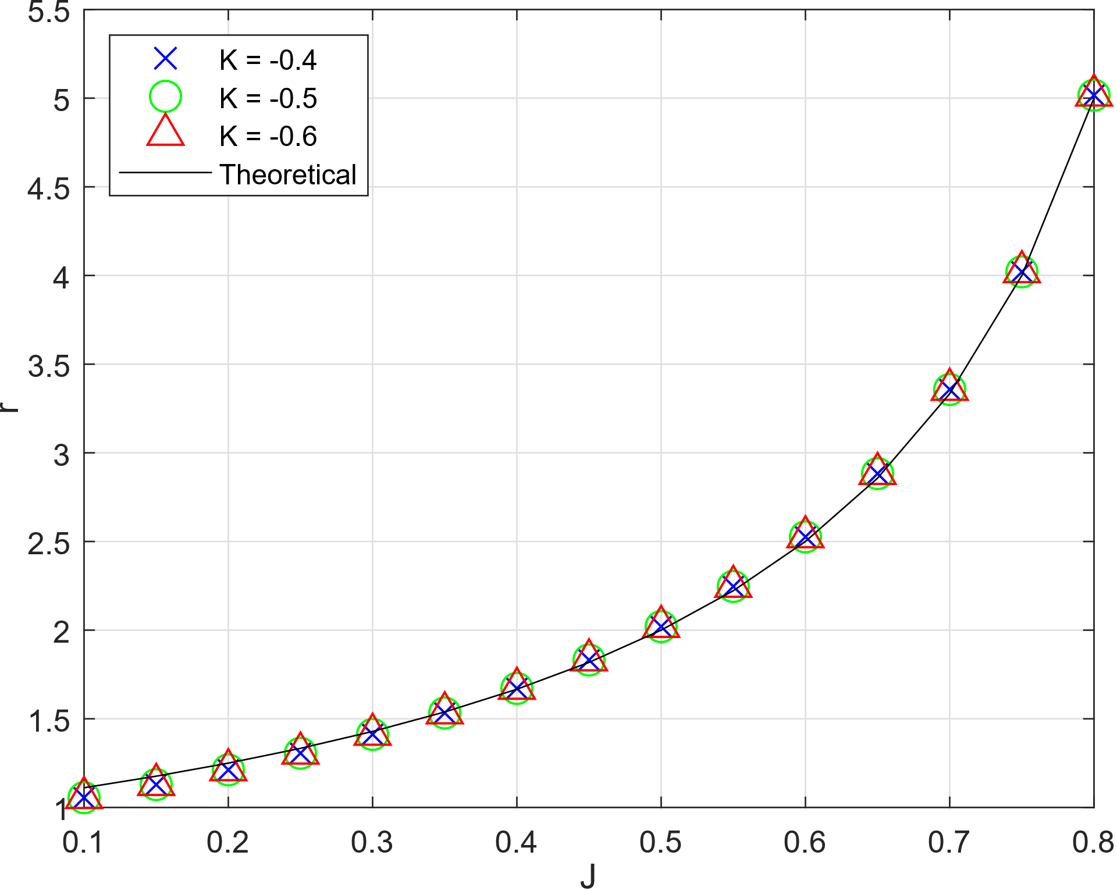
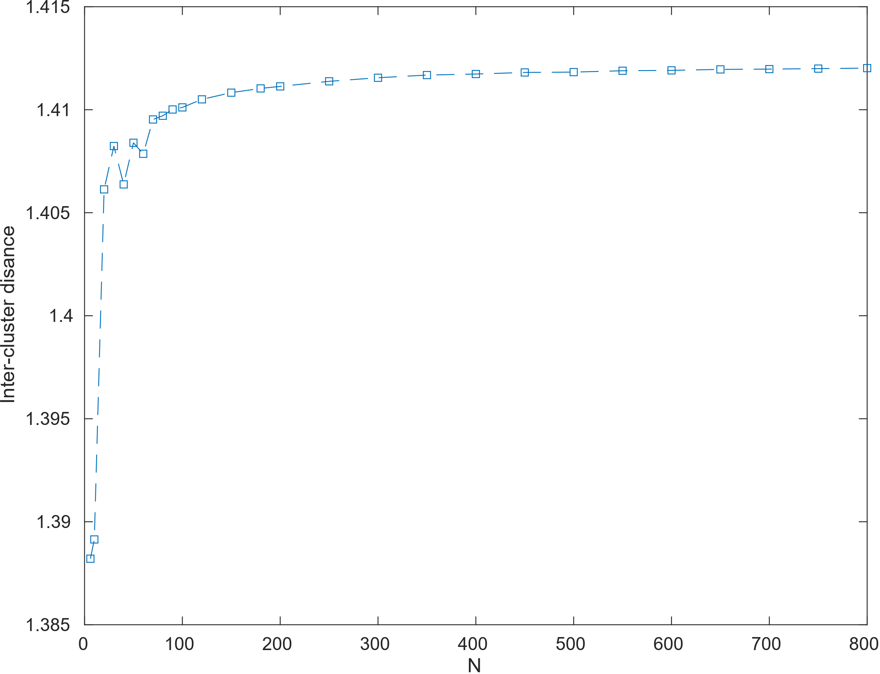
Inter-Cluster Distance
r =1.412
Inter-cluster distance for varying K. N = 800
Inter-cluster distance for varying N. K = -0.5,J = 0.3,

Slide 16
Two clusters with rogues

Slide 17
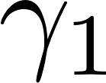
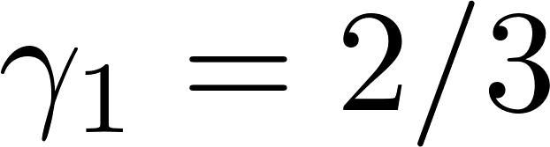
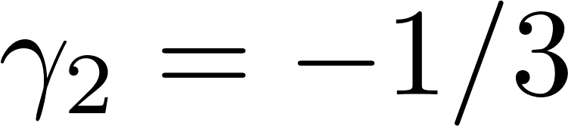
Two clusters with rogues
Non-stationary state which occurs for values of and “close” to 2/3 and -1/3.
Exact region not clearly known
Mostly occurs when
Cluster are closer to each other
N = 100.
Rogues pass through each other

Slide 18
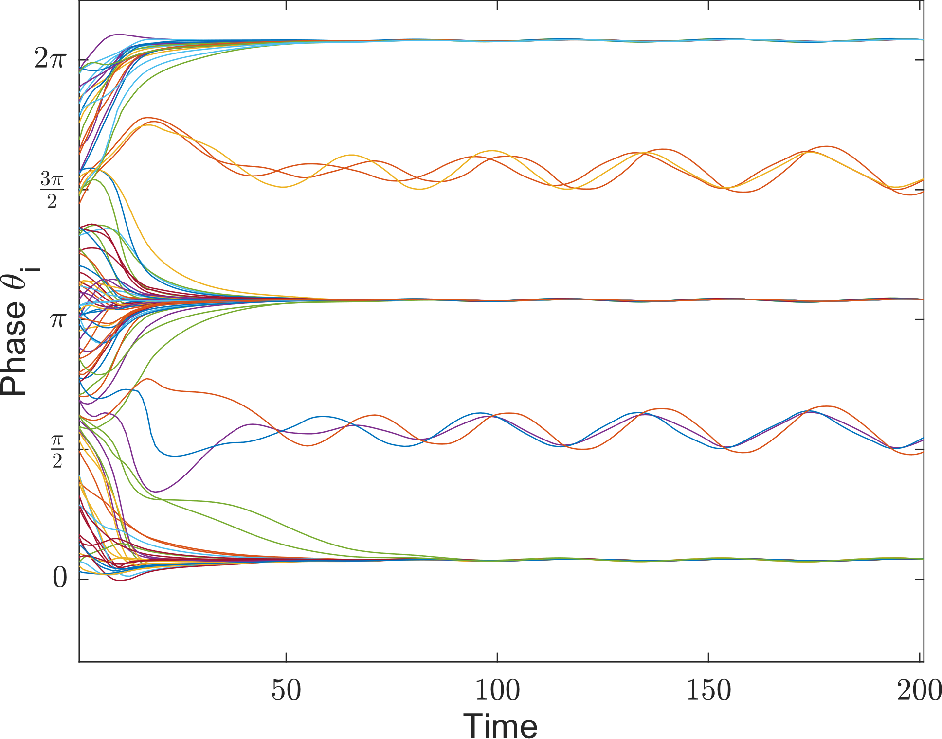

Two clusters with rogues
Rogues
The rogues would always form
clusters with similar phase
Big cluster phase difference is
Rogues average phase difference with cluster
Big clusters- small oscillations
Phase diff
Phase diff

Slide 19





Static bimodal single cluster
This state is achieved for with , and , or ,and
If the sign of is flipped, the state changes to static async
Phase difference between swarmalators
A similar state is achieved for
N = 100

Slide 20

Active three/four clusters
Special Extension of two clusters with rogues
Never achieved under random runs
Created by placing 20 swarmalators in the middle with phase
Such a state is also possible with three clusters.

Slide 21
Stability

Slide 22



Static Single cluster state – Simple case
Focus on phase stability
Calculate phase Jacobian matrix and look at its properties
First point of interest: ; phase shifting by a constant -> no change in dynamics
In a Single cluster:

Slide 23




Static Single cluster state – Simple case
where, with
Here M is a weighted Laplacian matrix, -> M is semi definite positive
Eigenvalues of J

Slide 24




Static Single cluster state – Simple case
Two clusters
Unstable single cluster case:
Small phase perturbation of order grow exponentially
The system breaks into 2 clusters
N = 100

Slide 25




Static Single cluster state
Linear Unstable. Perturbation grow linearly
Stable single cluster case: Perturbation case the system to reach new equilibrium

Slide 26





Static Two cluster state
Static bimodal single cluster state
Constructed two clusters with phase $0$ and $π$
Ran simulation for T = 2000 sec for N = 100,
Perturbed the phase by adding random numbers of order
: Unconditionally stable, all eigenvalues are $≤0$.
: Unstable; positive eigenvalues;
Eigenvalues of phase Jacobian matrix was $≤0$.
Adding perturbation always stabilized into a new equilibrium.

Slide 27
Periodic motion of rogues
We will briefly look into the motion of rogues two cluster 3-3 rogues.
Due to static nature of two clusters and small number of rogues, we expected to see some periodic behavior
Ran the simulation for T = 4000 time steps, the first half of which was discarded, and plotted the motion of the rogues to check if they formed closed loops.

Slide 28

Particles 1,2,3 are in one cluster and 4,5,6 in the other cluster

Slide 29





Slide 30



Slide 31


Circular Ring state (Unstable)
We tried out this special arrangement and looked into its characteristics.
The circumferential swarmalators collapse to a stable radius.
Destabilizes to two clusters after a while
N = 11,
0.5
Phase diff = $π$

Slide 32


Circular Ring state (Unstable)
Exponential growth
Stable radius
Distance between centroid and center particle
Breaks to two clusters

Slide 33


Circular Ring state (Unstable)
Decreasing abs and rel tolerance to ${10}^{−10}$ increased stable time a bit.
Further decrease didn’t increase stable time
Ran the simulation in “single precision mode” : Stable time decreased by about a third

Slide 34


Phase variation within the cluster
Phase of rogues set to 0
For static two cluster case, there was little to no phase variations
Static bimodal had either phase 0 or $π$
Two clusters with rogues had some interesting phase variation patters.
N = 400

Slide 35

GUI Interface
Used MATLAB App Designer to make GUI
Easy to implement callback functions
Drag and drop features
Don’t need crazy software making skills to make such application
Can change model parameters while simulation is running.
Don’t really know why it runs a bit slow

Slide 36

Future works
Conclusion
More analysis of known states
Maybe there are more states?
Bifurcation diagrams
Reduced or simplified model
More generalization of the model
More phase terms
Different attraction and repulsion kernels
Different
We examined the collective behavior of swarmalators
Looked into new states formed by these particles
We did some basic analysis on the states

Slide 37
Thank you!

